Slide 1
ALLIGATOR
Guide Name: Mr. Santosh Katti
Assistant Professor, Dept of CA
PES University
Vijaykumar R Pai - PES1201702013
Ayush Pratyay – PES1201702164
Chinmay Prajapat – PES1201801858

Slide 2
abstract
the objective of the project is to monitor hostile activities in the militarized zone.
Therefore, as soon as the camera detects some activity within its range, it starts recording the surrounding area. If it detects some suspicious activity, the camera will start focusing on that particular area under suspicion.
If the person is hostile, It will immediately alert the authorities to take necessary actions.
All the collected visuals will be stored on the cloud for future reference.

Slide 3
introduction
The project is designed to alert the authorities of hostile activities going around their premises. If the device detects any motion around designed radius it warns the respective authorities by activating the alarm.
Pi camera is used to capture the activity and analyse the surroundings.
PIR which is an Passive infrared sensor will help in activating the camera once the intrusion is detected within a certain distance.
Using the Wi-Fi module we can upload the details in the cloud and alert the authorities through notification.

Slide 4
Literature survey
there are many solutions to this problem and each of them have their own way of tackling the problem. They use thermal sensors to detect heat signatures and cameras sensitive to thermal readings.
These have certain drawbacks as they won’t be able to give accurate readings if the environment conditions are poor.
These problems can be tackled by implementing PIR Sensor which will alert the authorities once intrusion is detected.
Along with these sensors the authorities will be notified of any threat in the premises by activating the alarm.

Slide 5
Technologies used
Software Requirements
Raspbian OS
Front end: Python 3.7
Dropbox
Hardware Requirements
Raspberry Pi Model 3B
Raspberry Pi Camera Module
PIR Sensor
Buzzer
Jumper Wires

Slide 6
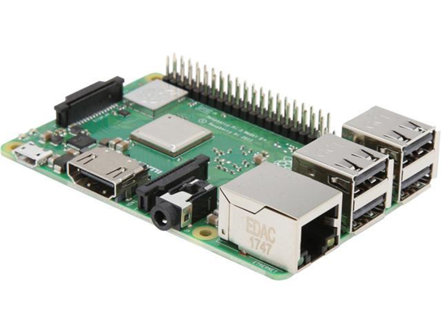
Raspberry Pi 3 B
The Raspberry Pi 3 Model B is the earliest of the third-generation raspberry pi.
It is powered by a 1.2 GHz Broadcom BCM2837 processor with BCM43438 wireless LAN.
It also has Bluetooth capabilities

Slide 7
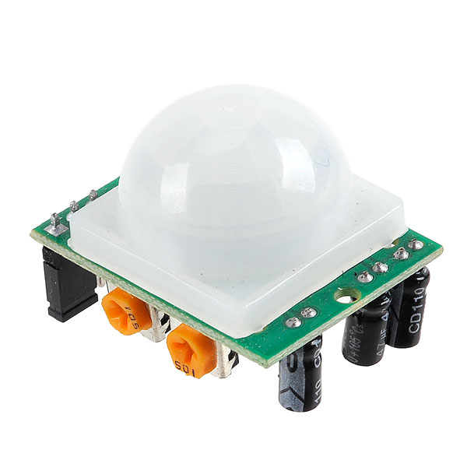
PIR sensor
A passive infrared sensor (pir sensor) is an electronic sensor that measures infrared (ir) light radiating from objects in its field of view. They are most often used in pir-based motion detectors.
The term passive refers to the fact that pir devices do not radiate energy for detection purposes. They work entirely by detecting infrared radiation (radiant heat) emitted by or reflected from objects.

Slide 8
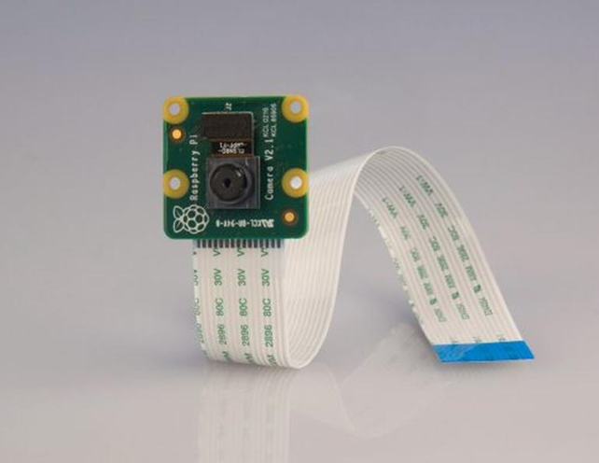
Camera module
The Raspberry Pi Camera Module v2 is a high quality 5 megapixel Sony IMX219 image sensor custom designed add-on board for Raspberry Pi.
It has the capability to record videos and take pictures at a resolution of 5 megapixels.

Slide 9

dropbox
Dropbox is a file hoisting service operated by the American company dropbox Inc. that offers cloud storage.
Dropbox helps us to store the captured images onto the cloud.

Slide 10
Functional Requirements
Detects if there is a motion in the environment.
Activates the camera and starts recording the surroundings.
Alerts the authorities.
Stores the recorded visuals on cloud for future use.

Slide 11
Non- Functional Requirements
Availability
Maintainability
Performance
Simplicity

Slide 12
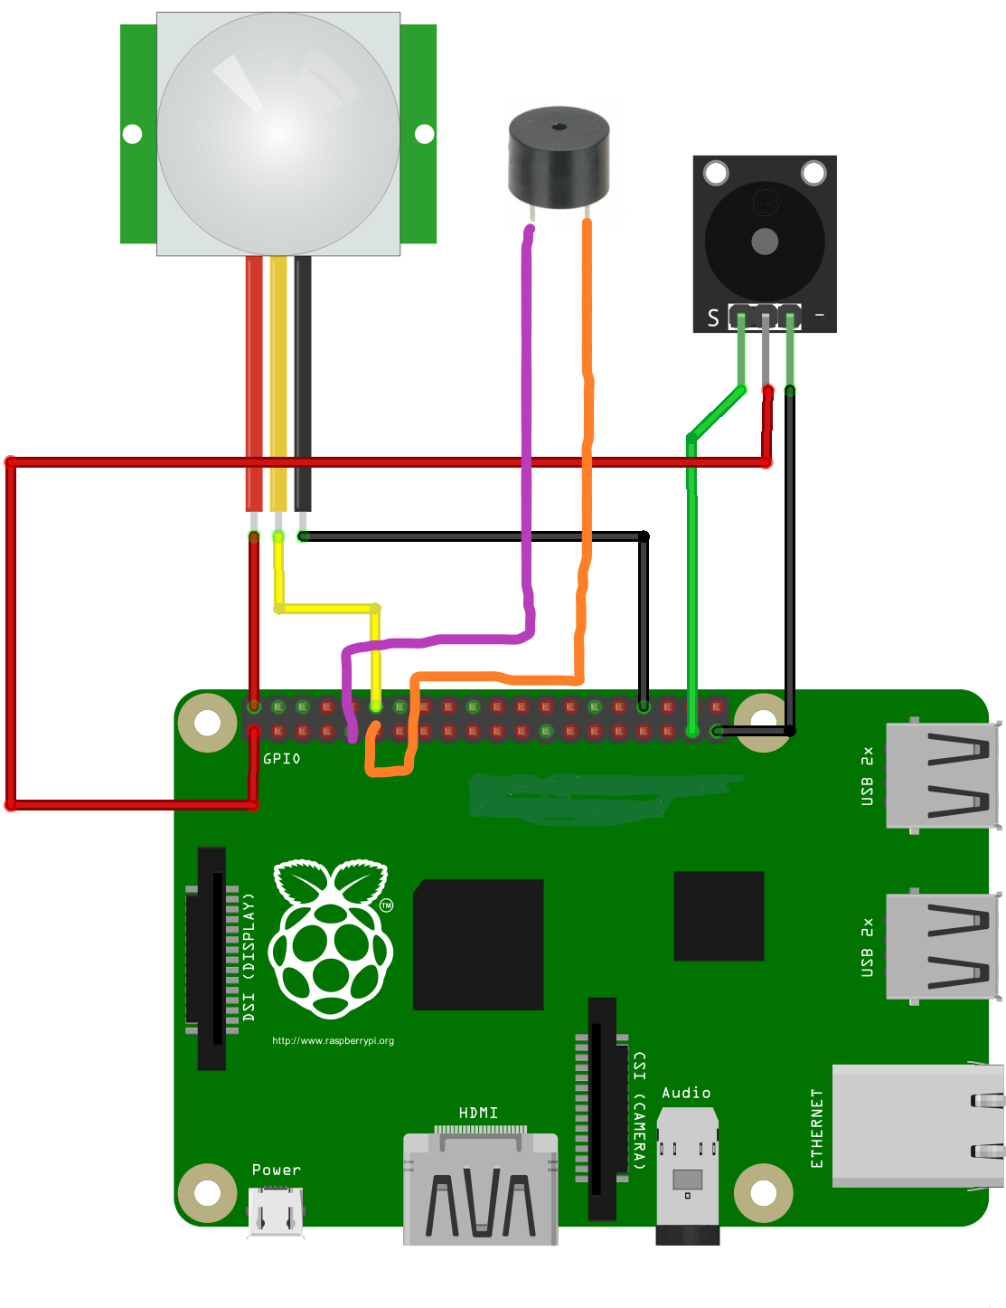
CIRCUIT DIAGRAM

Slide 13
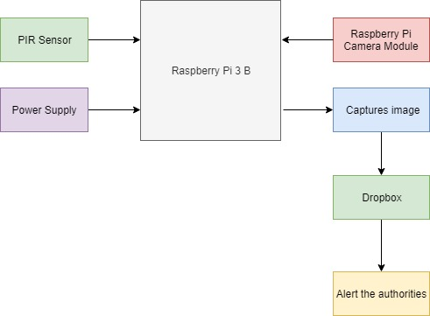
Block diagram

Slide 14
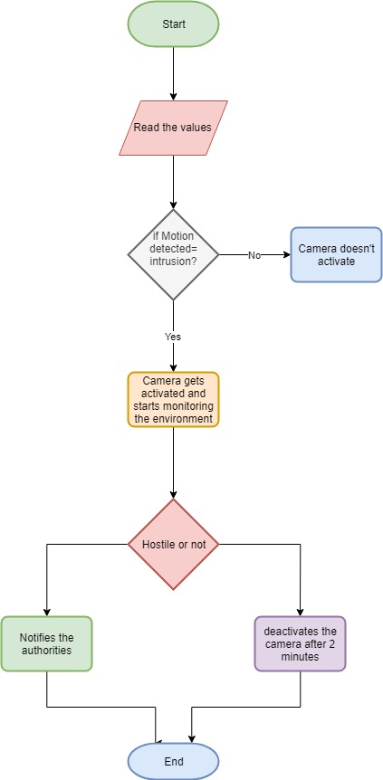
Flow diagram

Slide 15
Future enhancement
Future enhancement of our project is to add Camouflage and LIDAR sensor to it.
Internet of Things is a trending concept, which can increase the benefits of the smart surveillance by allowing it to adapt to the environment according to its changes ie if the Alligator is placed in the desert, it will change according to the desert’s atmosphere. Similarly, if it is placed in snowy regions, it will adapt to that atmosphere. Also by replacing PIR sensor with LIDAR (Light Detection and Ranging), which is a remote sensing method that uses light in the form of a pulsed laser to measure ranges (variable distance) the alligator will be able to detect motion from farther distances and will be able to alert the authorities much beforehand.
In order to run this integrated set of hardware we can use solar panels as an alternative to the battery, which will be needed to run the alligator once it is deployed.

Slide 16
Thank You

